Slide 1
Vanpé, C., J. Gaillard, P. Kjellander, A. Mysterud, P. Magnien, D. Delorme, G. V. Laere, F. Klein, O. Liberg, and A. J. Mark Hewison. 2007. Antler Size Provides an Honest Signal of Male Phenotypic Quality in Roe Deer. The American Naturalist 169:481–493.
Article: Antler Size Provides an Honest Signal of Male Phenotype Quality in Roe Deer
Question: How is absolute and relative antler size influenced by age and environmental factors in roe deer?

Slide 2
Response Variable and Predictors
Response Variable: Antler Size
Predictors:
Allometric Variation
Age (yearling, prime-age, senescent), Body Mass, and Population
Environmental Factors
Resource Availability, Habitat Quality, Climate

Slide 3
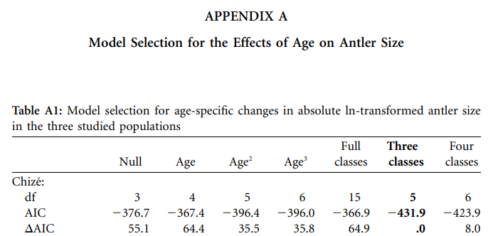
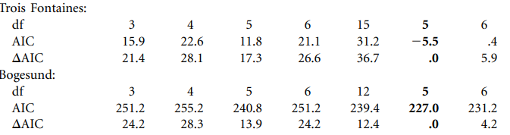
AIC Table

Slide 4
Important Models
Full
Best describer of allometric variation
Three classes
Best model, ΔAIC = 0

Slide 5
Concluding Remarks
Age and body mass had a higher impact on antler size than environmental factors
Prime-age males had large antlers compared to yearling and senescent males
Antler size increased with larger body mass

